Slide 2
Welcome and introduction
Bénédicte Paviot
Journalist
➔ Live webstream
Join the conversation #LabourShortages

Slide 3
Cosmin BOIANGIU
ELA Executive Director

Slide 4
Ivailo KALFIN
Eurofound Executive Director

Slide 5
Mario NAVA
Director General DG EMPL, European Commission

Slide 6
Company practices to address labour shortages: Lessons from Eurofound research
Tina Weber
Research Manager, Eurofound
➔ Live webstream
Join the conversation #LabourShortages

Slide 7

Scale of shortages faced by employers

Slide 8
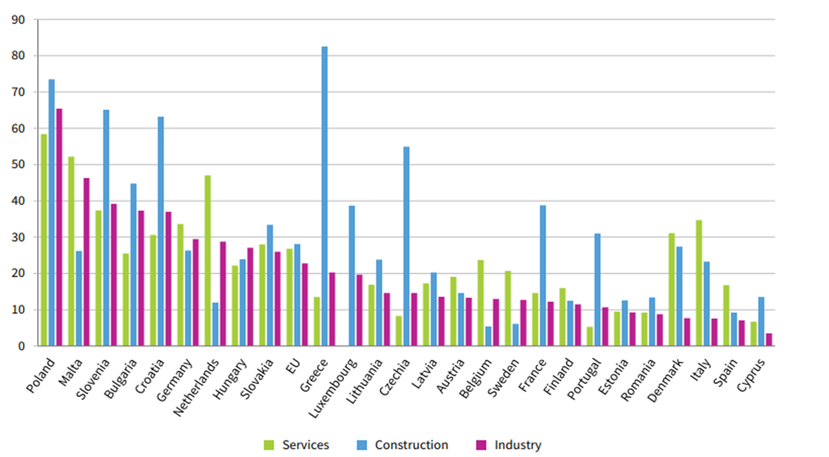
Labour as a factor limiting production/service delivery (Q1 2024)

Slide 9
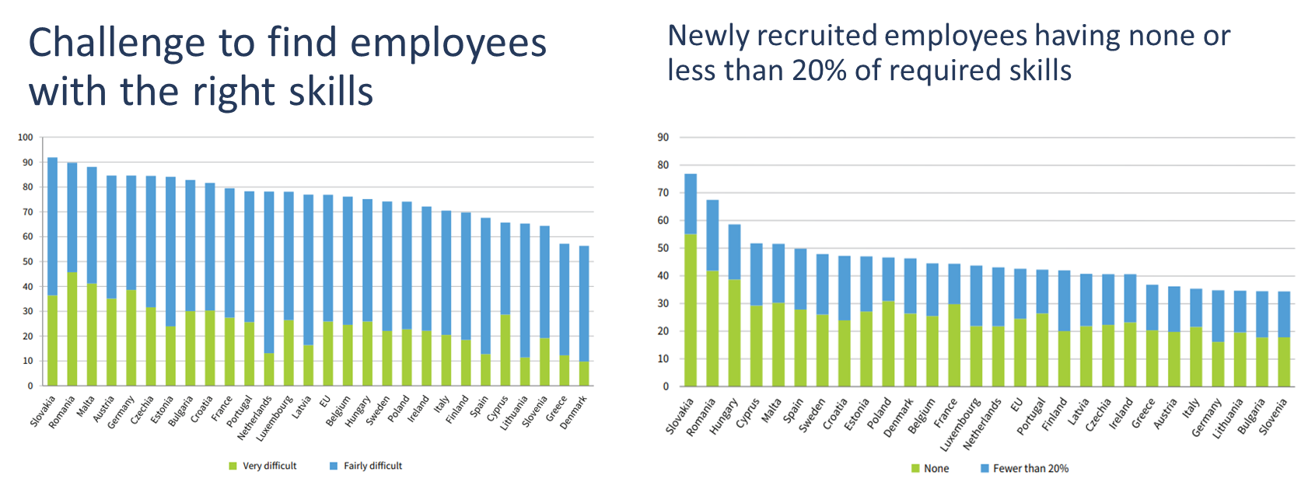
Challenge of find employees with the right skills (ECS, 2019)

Slide 10

Measures taken by employers to address shortages

Slide 11
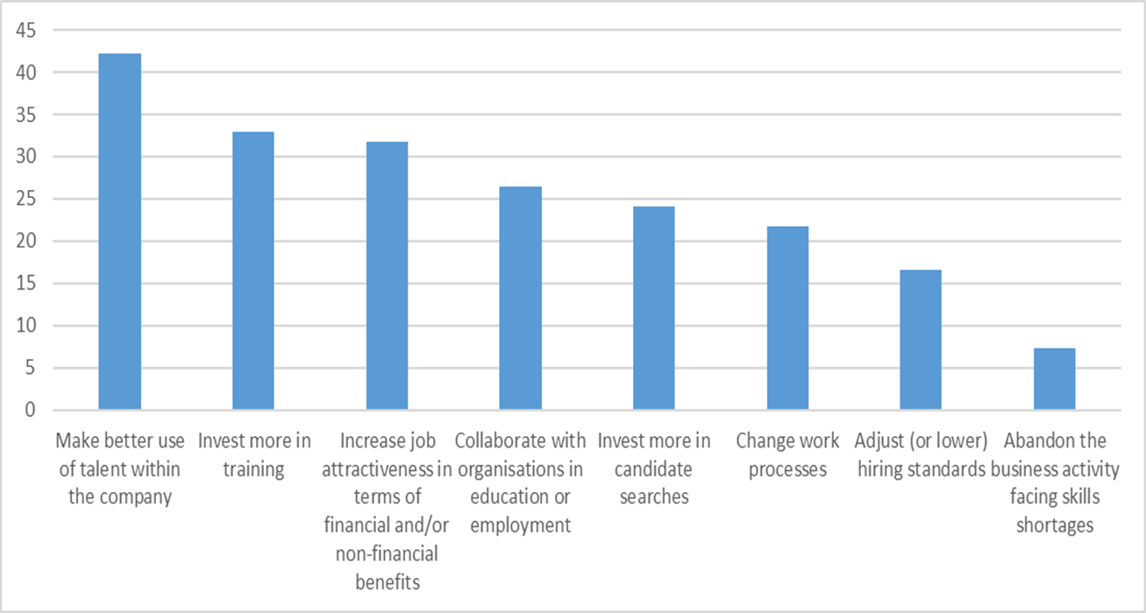
Measures taken by SMEs when faced with skill shortages (Eurobarometer 529, 2023)

Slide 12
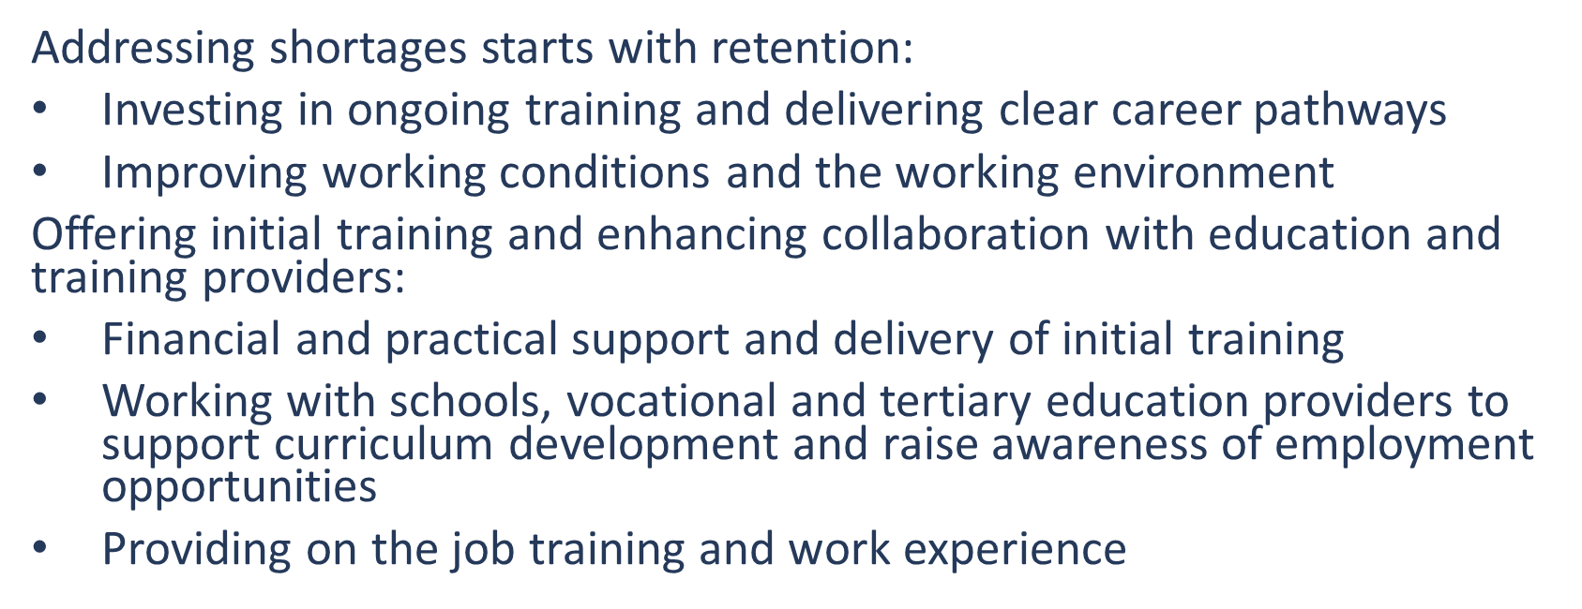
Improve the match between supply and demand

Slide 13
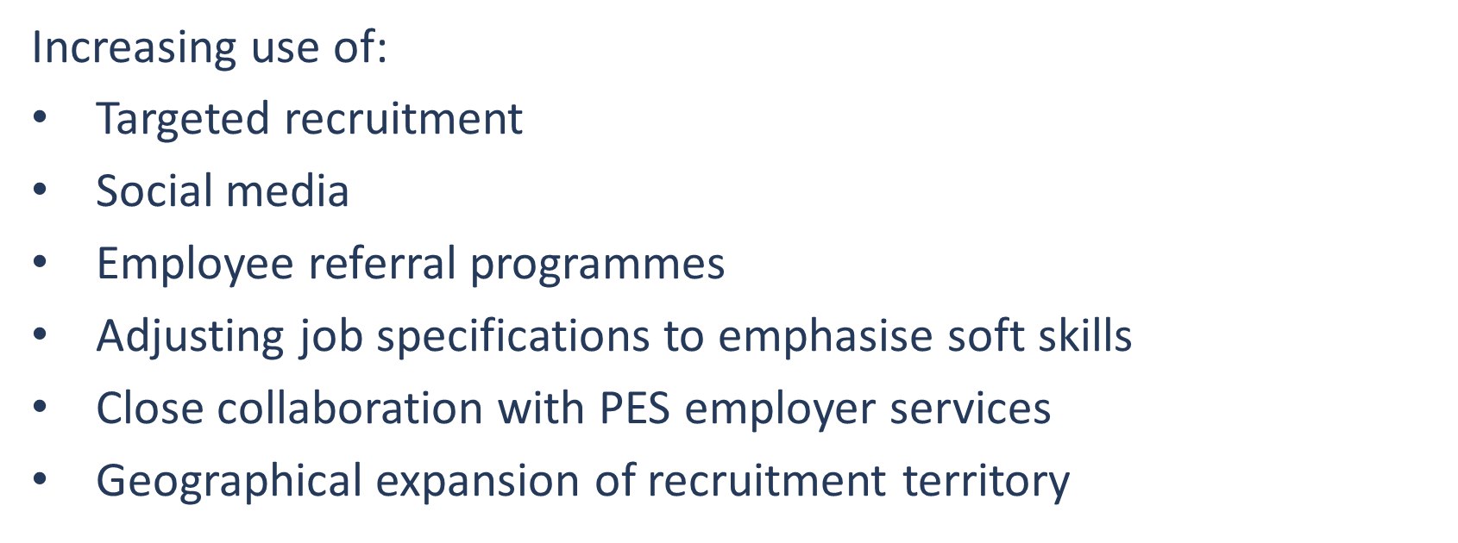
Enhanced recruitment strategies

Slide 14
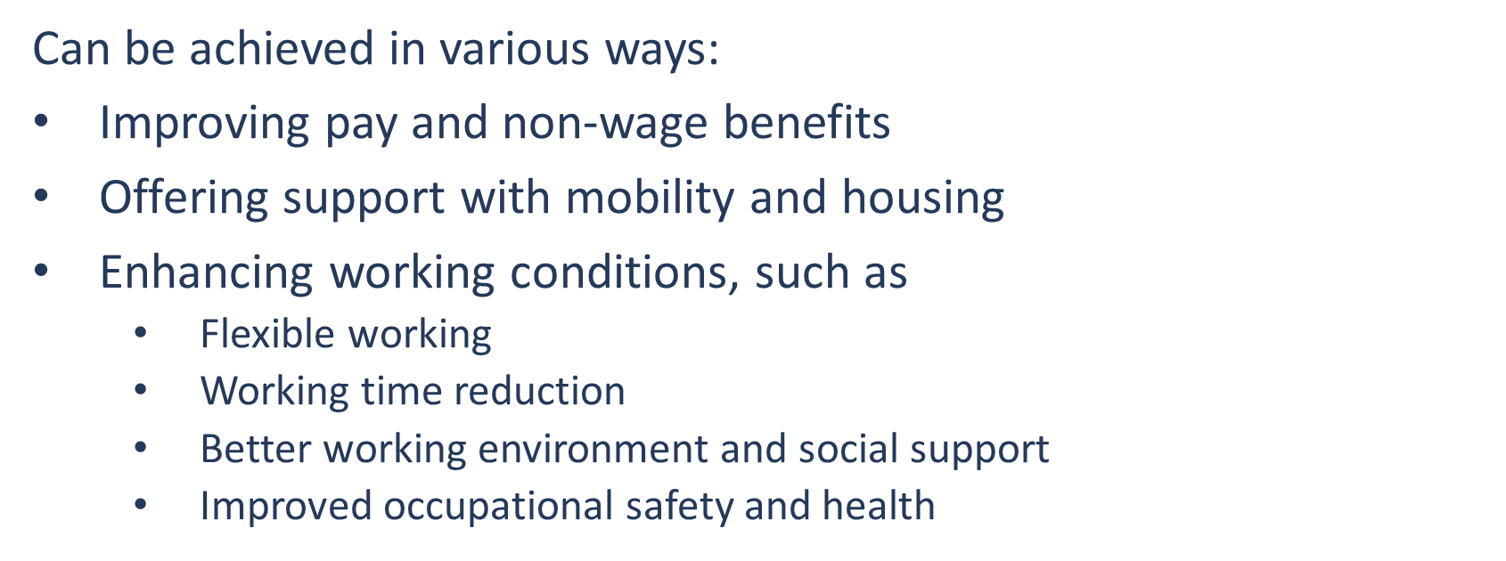
Increase attractiveness of work and workplaces

Slide 15
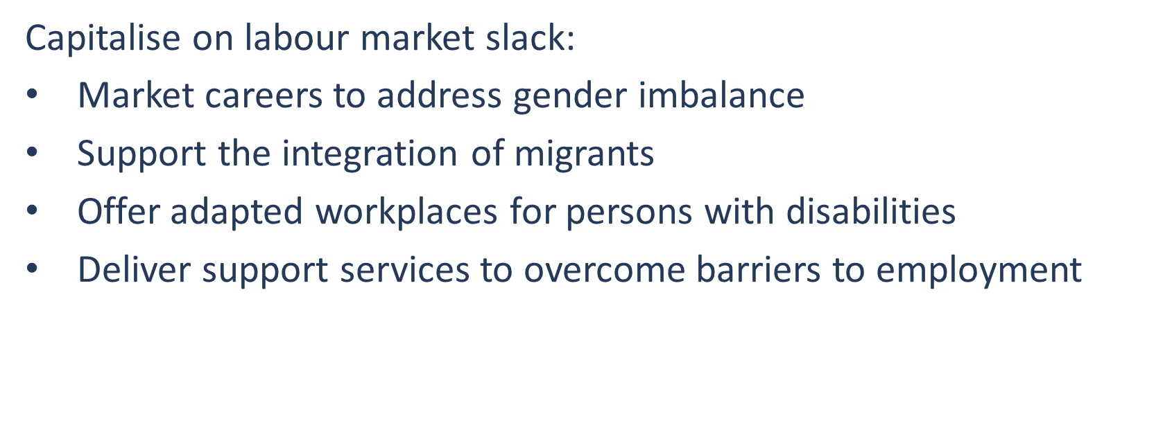
Target underrepresented groups

Slide 16


Slide 17
Successful practices to address labour shortages: company cases
➔ Live webstream
Join the conversation #LabourShortages

Slide 18
Successful practices to address labour shortages: company cases presentation
• Na Františku hospital Prague
Jana VÁŇOVÁ and Yvona VLČKOVÁ
• Cyprus Public Transport
Christina KOKKINOU
• Love Carpe Diem, Croatia
Bojana KULIS BUBALO

Slide 19

Hospital Na Františku, Prague, Czech Republic

Slide 20
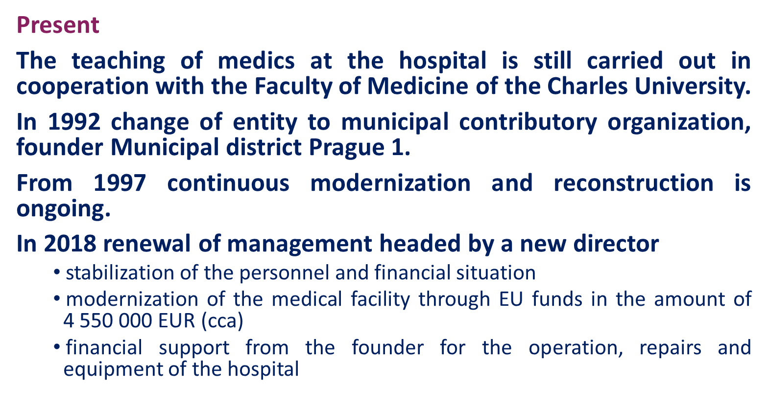
Hospital Na Františku, Prague, Czech Republic

Slide 21
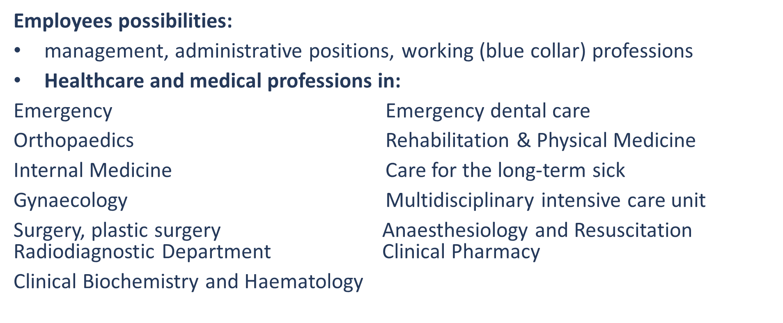
Hospital Na Františku, Prague, Czech Republic

Slide 22
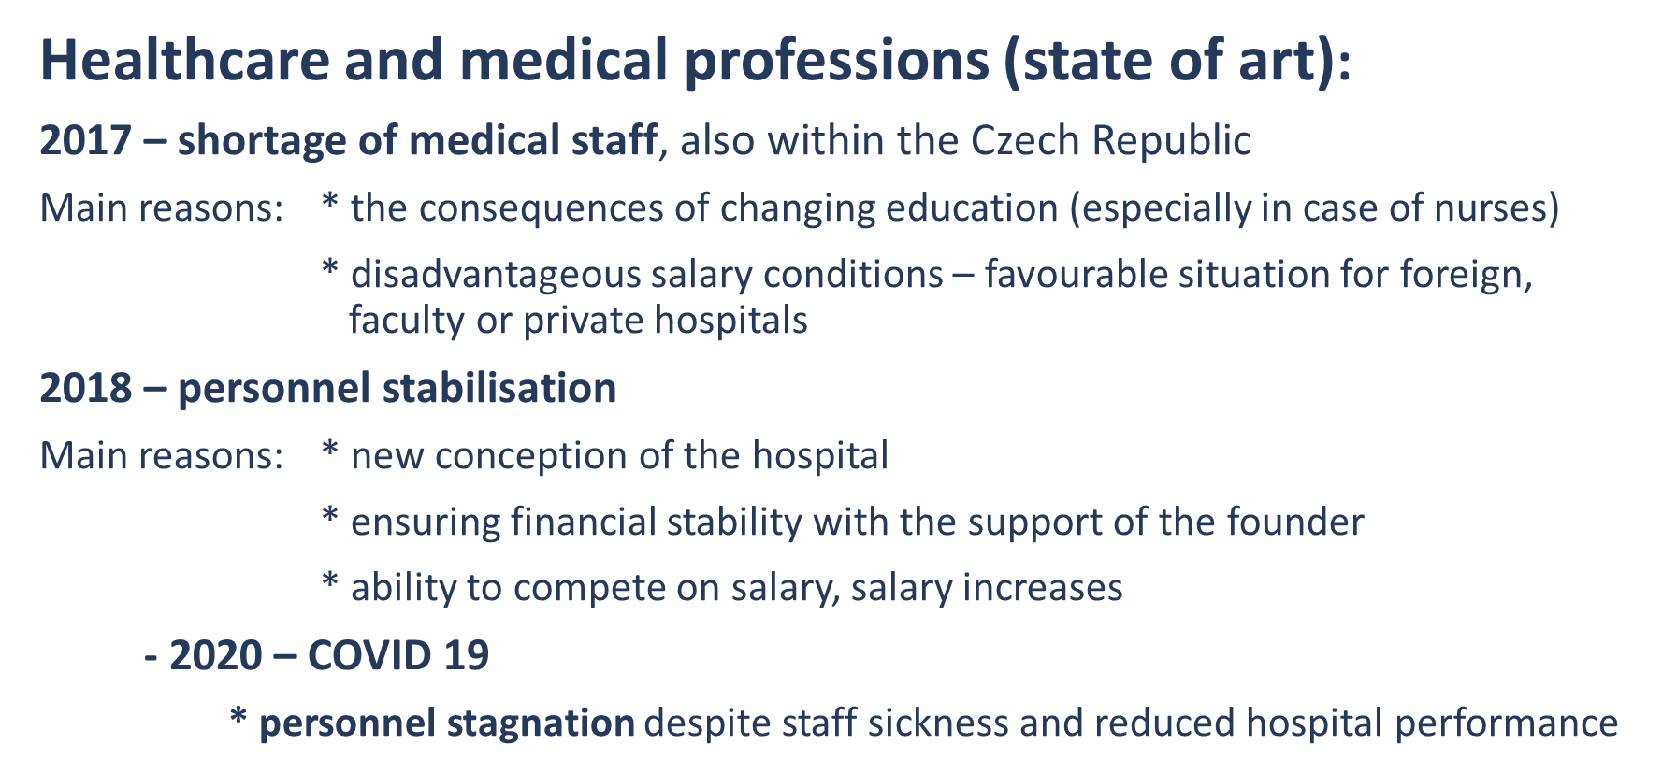
Hospital Na Františku, Prague, Czech Republic
Employer

Slide 23
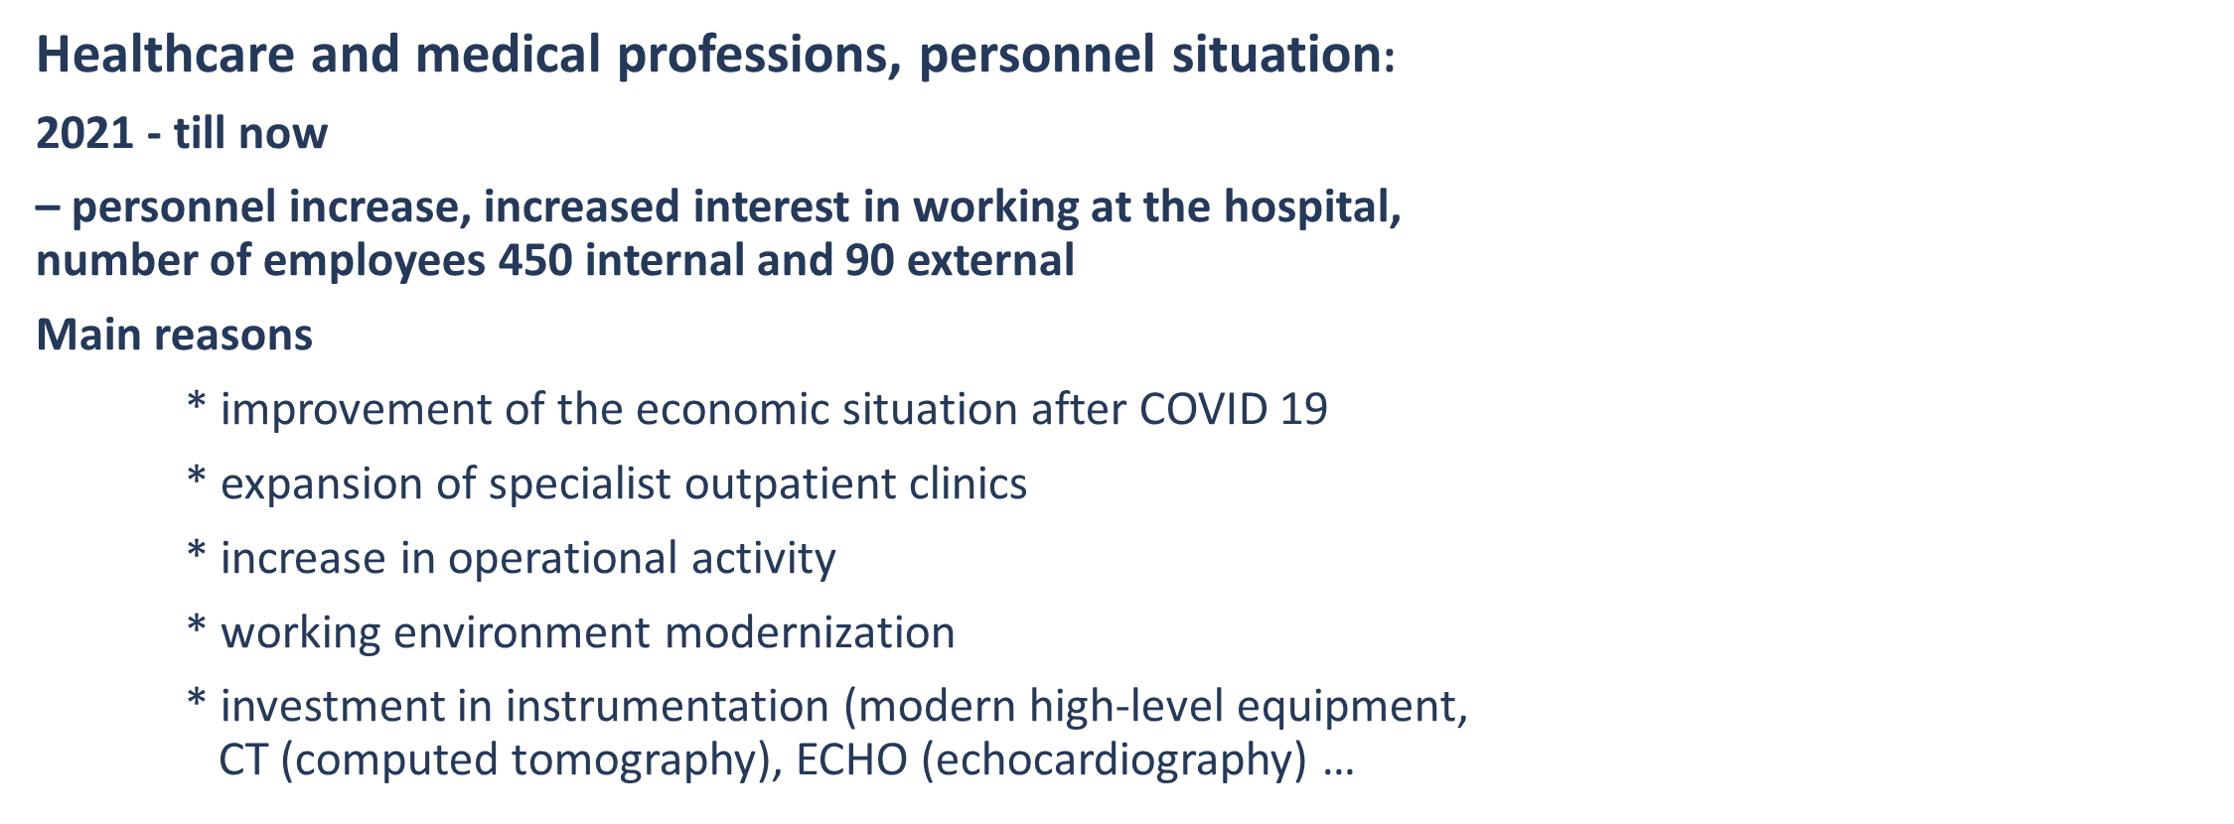
Hospital Na Františku, Prague, Czech Republic
Employer

Slide 24
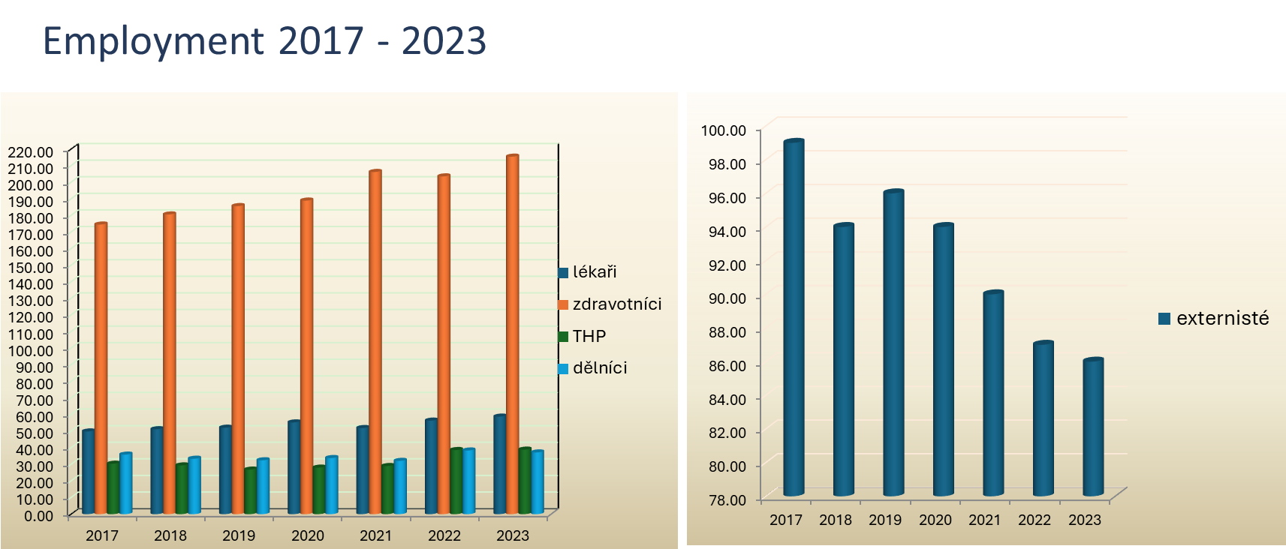
Hospital Na Františku, Prague, Czech Republic
Employer

Slide 25
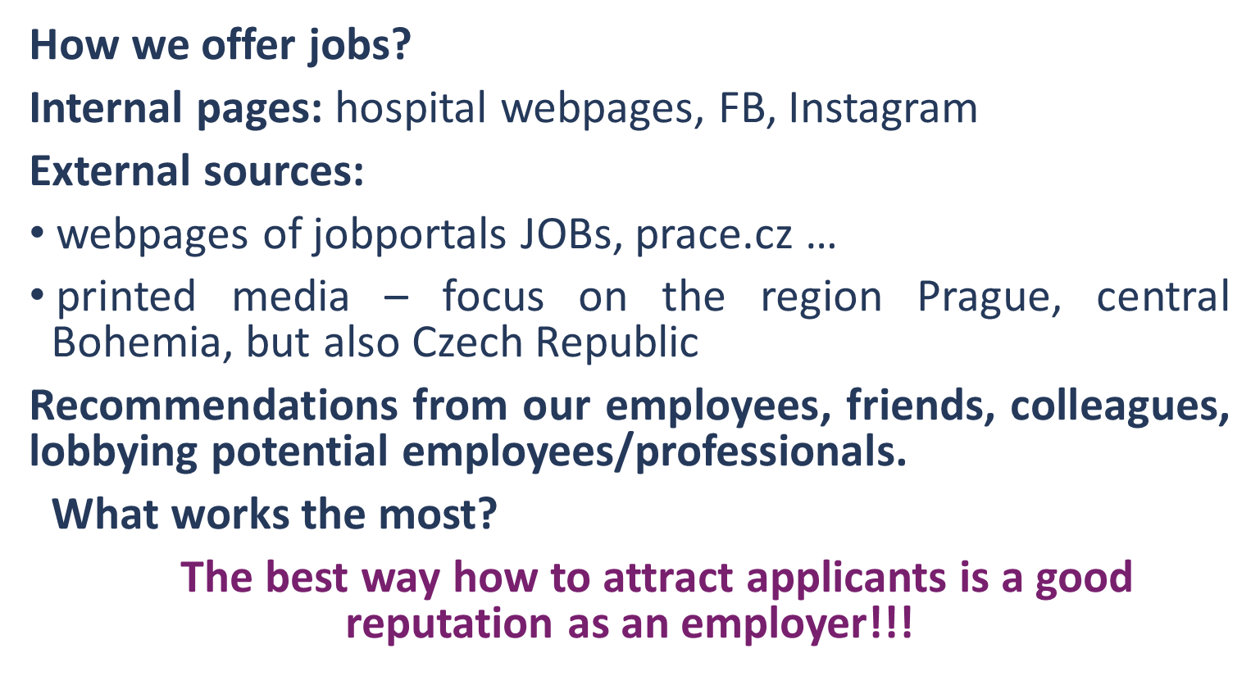
Hospital Na Františku, Prague, Czech Republic
Employer

Slide 26
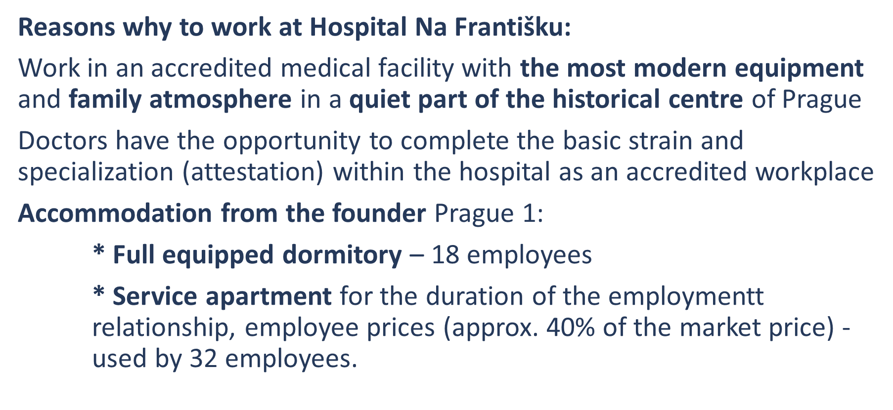
Hospital Na Františku, Prague, Czech Republic
Employer

Slide 27
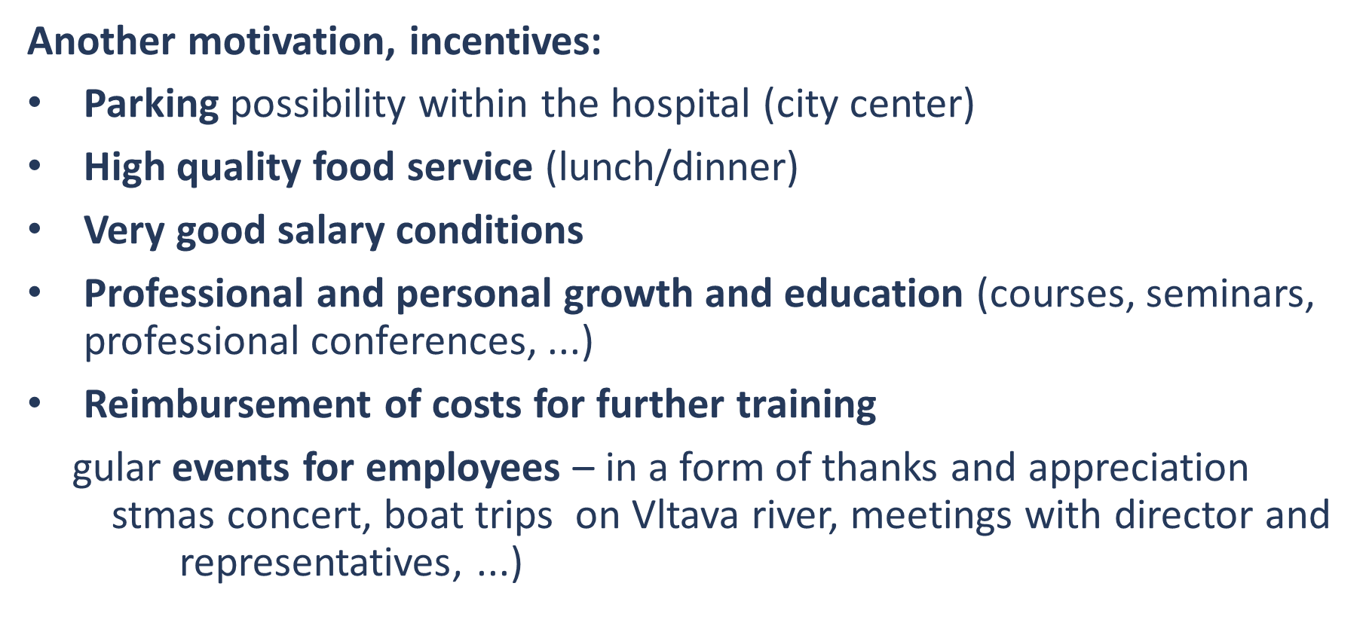
Hospital Na Františku, Prague, Czech Republic
Employer

Slide 28
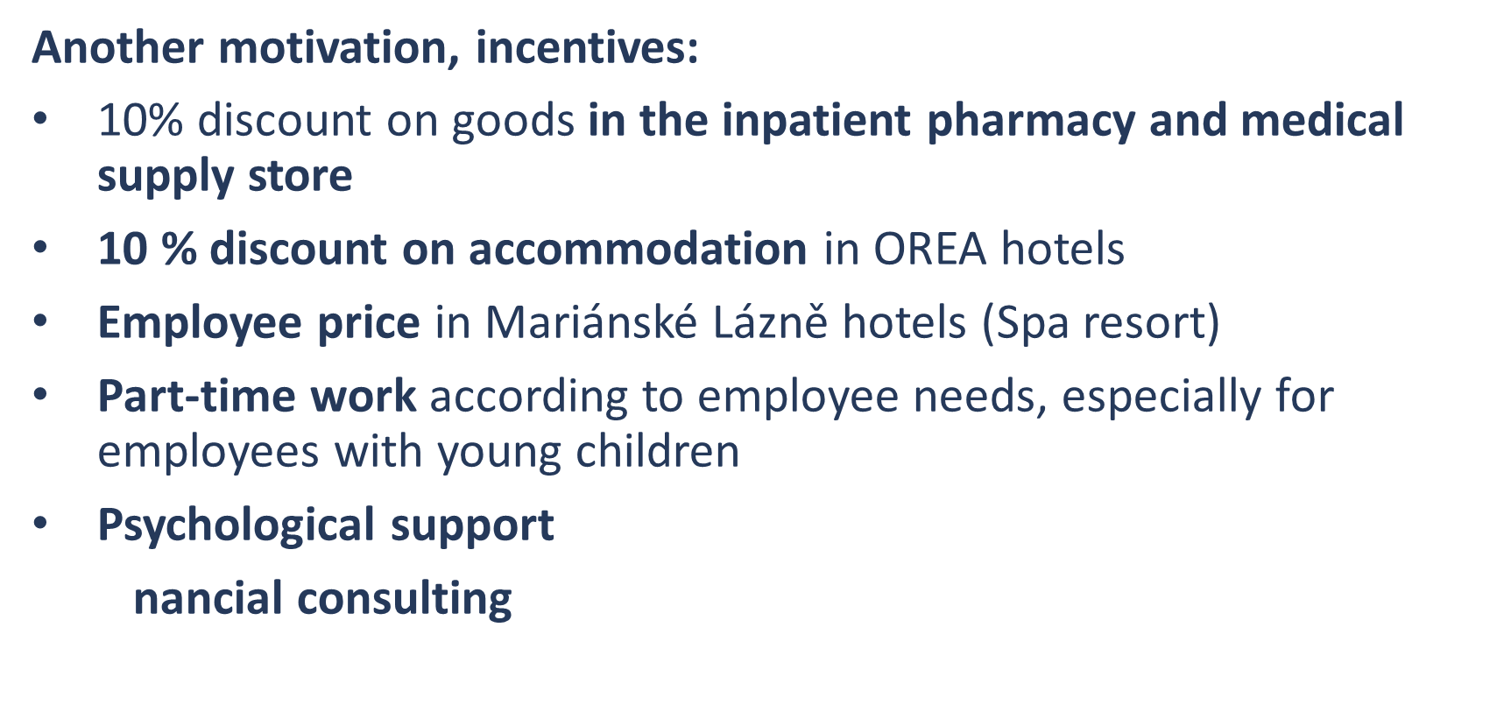
Hospital Na Františku, Prague, Czech Republic
Employer

Slide 29

Hospital Na Františku, Prague, Czech Republic
Employer

Slide 30


Slide 31


LOVE
CARPE DIEM
PAST - PRESENT - FUTURE
  CROATIAN COMPANY IN FULLY PRIVATE OWNERSHIP
  TEAM WITH OVER 30 YEARS OF EXPERIENCE IN TOURISM
  PROVIDES SERVICES FOR HOTELS AND RESORTS

Slide 32

INTRO
DUCTION
  EMPLOYING APP 500 PEOPLE IN SUMMER SEASON / APP 100 IN WINTER SEASON
  JOB POSITIONS: TOURIST ENTERTAINERS, HOUSEKEEPING STAFF, CLEANERS, ADDITIONAL STAFF FOR KITCHEN, CERTIFICATED STAFF FOR WELLNESS AND SPA CENTRES
  OVER 50 HOTELS IN CROATIA
  SLOVENIA, AUSTRIA (POSTED WORKERS), SE ASIA (IN COOPERATION WITH PARTNER COMPANY WHICH PROVIDES SERVICES ACCORDING OUR STANDARDS)
  FRENCH STANDARD - COOPERATION WITH AGENCIES - ANIMATION CLUBS IN 6 COUNTRIES)
  EMPLOYING PEOPLE FROM EU, BUT ALSO 3RD COUNTRIES

Slide 33
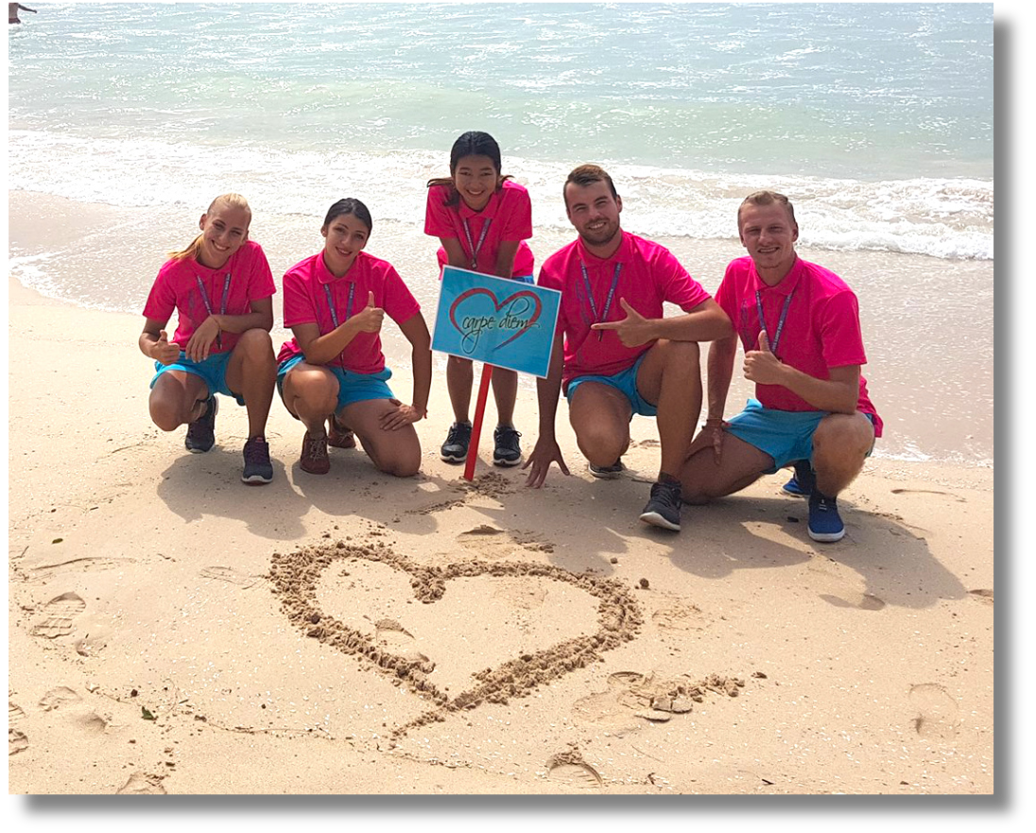
TOURISM
ENTERTAINMENT
  cooperation with various hotels, tourist resorts, camping villages and agencies
  flexibility in approach
  kids and family hotels, adult only hotels, luxury hotels, club agencies
  all sorts of specialised programs designed according partner needs
  search for talents who speak native German, Italian, French, Polish, Czech,...
  certificates for kids care (nannies), fitness trainers, yoga & pilates teachers, performers, artists, circus artists, dancers...
  FROM 2005 - 2013 BIGGEST SELECTION IN TOURISM IN CROATIA

Slide 34
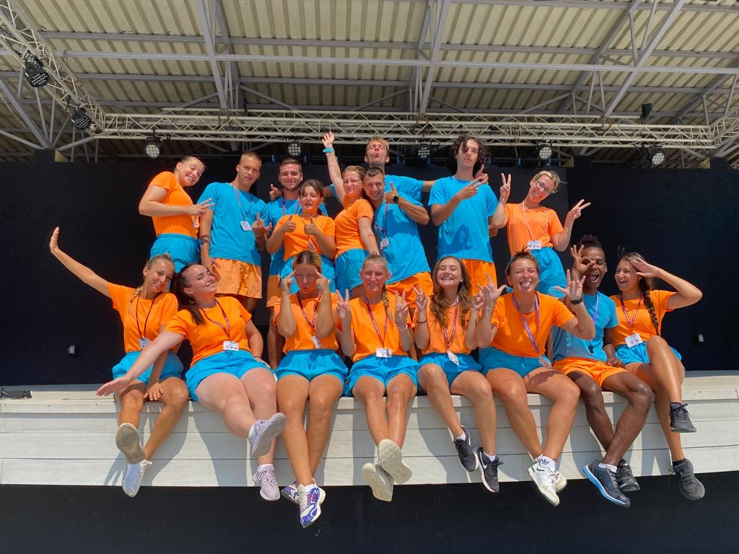

SUCCESSFUL
COOPERATIONS
  HZZ - CROATIAN GOVERMNET EMPLOYMENT SERVICE
  EURES
  UNIVERSITIES
  OFFICES FOR NATIONAL MINORITIES
  INTERNET MARKETING
  MUSIC, LANGUAGE, TOURISM AND ART SCHOOLS
  COOPERATION WITH EDUCATIONAL INSTITUTIONS (ORGANISING EDUCATION OF OUR STAFF ACCORDING NEEDS - CERTIFICATION OF NANNIES)

Slide 35
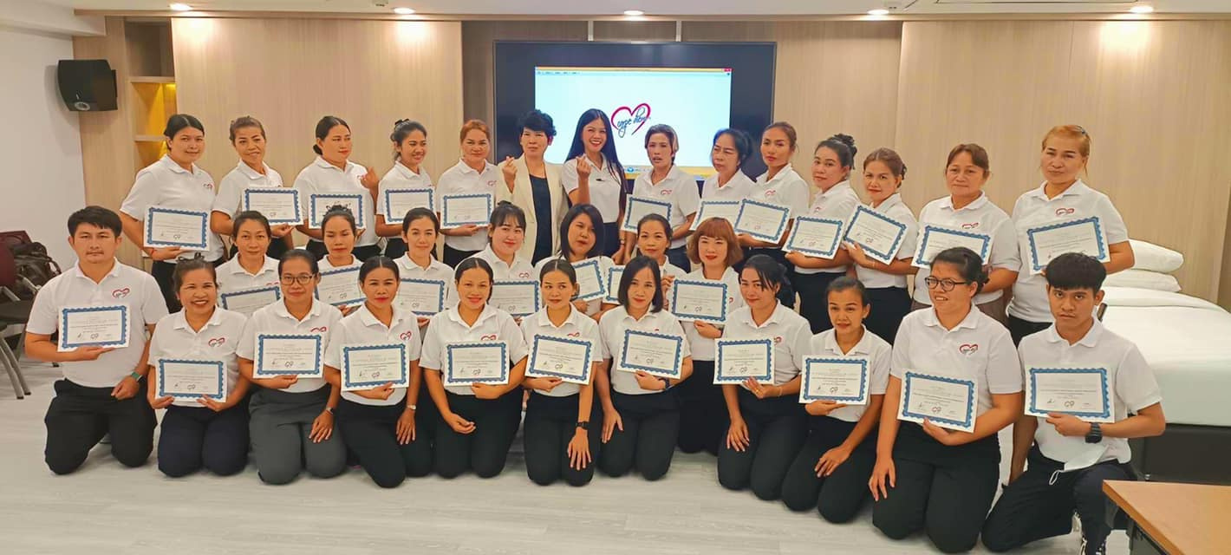
NEW SERVICES
  ON REQUEST OF PARTNER HOTELS, WE STARTED WITH ORGANISATION OF OTHER HOTEL DEPARTMENTS
  EMPLOYING PEOPLE FROM THAILAND, BUT ALSO SOUTH AMERICA AND EU
  PARTNER COMPANY IN THAILAND WHICH ORGANISES EDUCATION ACCORDING EU HOTEL STANDARDS
  MEMBER OF NEW CRO-THAI CHAMBER OF ECONOMY
  MEMBER OF CROATIAN EMPLOYERS’ ASSOCIATION
  TECHNICAL AND ADMINISTRATIVE CHALLENGES

Slide 36
OUR
CHALLENGES
  SHORTAGES OF STAFF - SPECIALLY IN SECTOR OF TOURISM ENTERTAINMENT
  SPECIAL REQUIREMENTS WHEN IT COMES TO SKILLS OF WORKERS
  POSTING WORKERS TO OTHER COUNTRIES / MEMBERS OF EU
  EMPLOYING PEOPLE FROM EU / 3RD COUNTRIES WITH NO VISA REQUIREMENTS / 3RD COUNTRIES WITH VISA REQUIREMENTS
  FOLLOWING AND PROVIDING HELP TO WORKERS FROM APPLICATION START TILL ARRIVAL TO CROATIA
  PROVIDING HELP AND ASSISTANCE IN LEGAL MATTERS (WP AD VISAS IF NEEDED, OIB (CRO TAX NUMBER), OPENING BANK ACCOUNT ...
  DISLOCATION OF DESTINATIONS WHERE WE WORK

Slide 37
HOW WE ASSIST
OUR WORKERS?
1
MARKETING, APPLICATION, SELECTION, LEGAL PART (CONTRACTS, SOP)
ACCOMODATION, FULL BOARD, SALARY ACCORDING PREVIOUS OR DEVELOPED SKILLS, KNOWLEDGES
4
2
ONLINE EDUCATION, VIDEOS, PREPARATION BEFORE ARRIVAL TO DESTINATION
PROVIDING HELP AND ASSISTANCE IN LEGAL MATTERS (TAX NUMBERS, OPENING BANK ACCOUNT ETC)
5
3
ON THE JOB EDUCATION, EXPERIENCE, POSSIBILITY OF SEASONAL OR WHOLE YEAR-ROUND EMPLOYMENT
FEEDBACK AFTER THE SEASON - POSSIBILITY OF LONG-TERM COOPERATION AND ADVANCEMENT
6

Slide 38
QUESTIONS...

Slide 39





CONTACT
INFO
+385 919082965
www.carpe.diem.hr
info@carpe-diem.hr
ZAGREB, CROATIA
THANKS FOR
WATCHING

Slide 40
How EURES can help employers to find workers
Robert KOMAROMI
Seconded National Expert, ELA
Astrid SOSTMANN
Astrid SOSTMANN
Expert, EURES Germany
➔ Live webstream
Join the conversation #LabourShortages

Slide 41

The EURES story is …
Notes:
Since its launch in 1994, EURES has been a network for cooperation between the Commission and the PES to provide information, advice and recruitment or placement for workers and employers, as well as any citizen of the Union wishing to benefit from the principle of the free movement of workers,
As EURES was founded in 1994 and we are now in 2024 - EURES is a 30-year-old network supporting the free movement of workers initiative ….

Slide 42
EURES works in close cooperation with employers
Advertise jobs
Find candidates
Contact jobseekers
Financial support for moving abroad through EURES Targeted Mobility Scheme (EC DG EMPL instrument)
Notes:
+
information on taxation, work contracts, pension entitlement, health insurance, social security and active labour market measures (e.g. training schemes, employment subsidies, assistance with job search) (Article 26);
Guidance for frontier workers and employers in cross-border regions (Article 27);

Slide 43
EURES services in numbers
Over 1 000 EURES staff and more than 270 organisations in 31 countries
3 million jobs posted on the EURES portal
Number of EURES portal visits (unique page views): over 25 million
European (Online) Job Days – about 30 events per year with
20 000 jobs and more than 50 000 jobseekers
Notes:
The EURES portal is more than a job portal
Jobseekers can find EURES advisers in their region,
living and working conditions and labour market information in 'plain language' on the portal + in all official EU languages
Analysis on labour shortages and surpluses
25 million visits: more then population of LUX, CZ, AT, SK, and HU …

Slide 44
EURES services to employers – some examples
AT-FR: cooperation with tourism schools in France for internship placement in Austria
BE Wallonia: specific job day for the gaming sector, surplus in Wallonia - shortages in MT, DE, CZ
IE: EURES Key Account Managers to assist employers
EE: recruitment projects for ICT companies

Slide 45
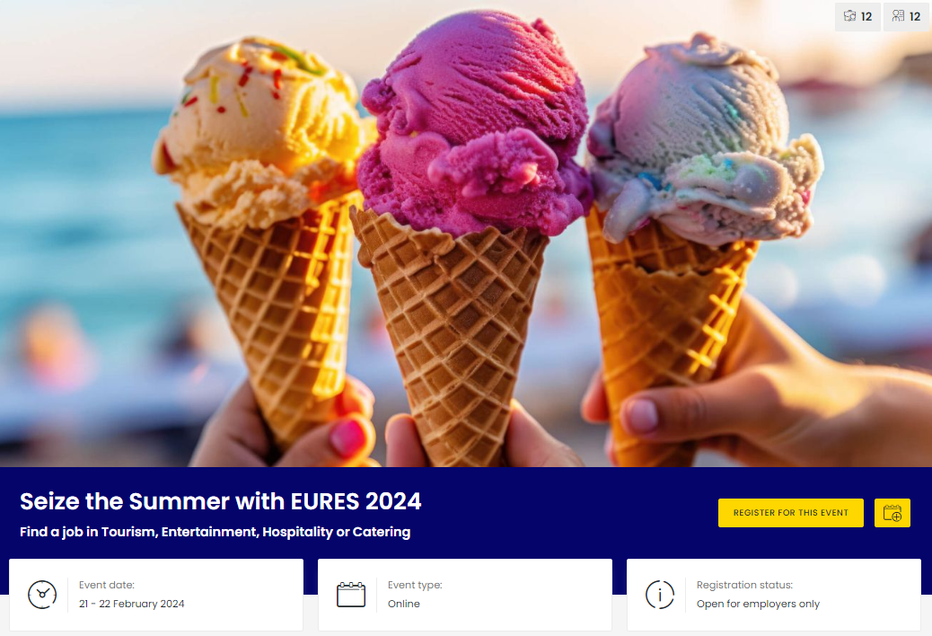
European (Online) Job Day – HORECA focus
The event is exclusively focused on HORCEA employers based in Croatia, Cyprus, France, Greece, Italy, Malta, Portugal, Slovenia, Spain.

Slide 46
COFFEE BREAK

Slide 47
Expected labour shortages in the future and how to support employers to cope
➔ Live webstream
Join the conversation #LabourShortages

Slide 48
Expected labour shortages in the future and how to support employers to cope
Michael FREYTAG
Public Affairs Manager, World Employment Confederation
Arne FRANKE
Chair of migration and mobility working group, BusinessEurope
Valentina GUERRA
Director, Social Affairs & Training Policy, SMEunited
Irma VIJVERBERG
Head of EURES NCO, The Netherlands

Slide 49
Questions & Answers
Bénédicte Paviot
Journalist
➔ Live webstream
Join the conversation #LabourShortages

Slide 50
Closing
Bénédicte Paviot
Journalist

Slide 51
Cosmin BOIANGIU
ELA Executive Director

Slide 52
Ivailo KALFIN
Eurofound Executive Director

Slide 53
LUNCH

Slide 54
Thank you
eurofound.europa.eu
ela.europa.eu
eures.europa.eu

